Slide 1
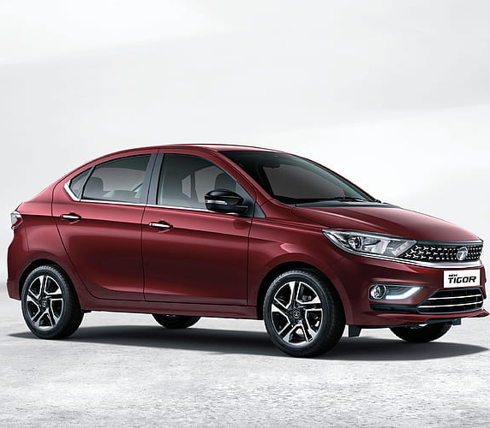
Vehicle Analysis 2005-2020
Amish Ilyas

Slide 2
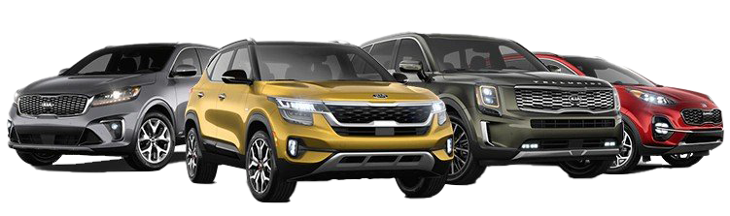
Problem Statement
Business Problem: Optimizing Used Car Pricing and Inventory Management
In the competitive used car market, optimizing pricing and inventory management is crucial for profitability and customer satisfaction. Key variables to analyze include vehicle name, year, selling price, kilometers driven, fuel type, seller type, transmission, ownership history, mileage, engine capacity, max power, and number of seats. By leveraging data analytics on these factors, we aim to:
1. Develop accurate pricing strategies.
2. Manage inventory efficiently to reduce holding costs and maximize sales.
3. Identify market trends and customer preferences.
The goal is to increase profit margins, reduce inventory times, and enhance the customer experience.

Slide 3
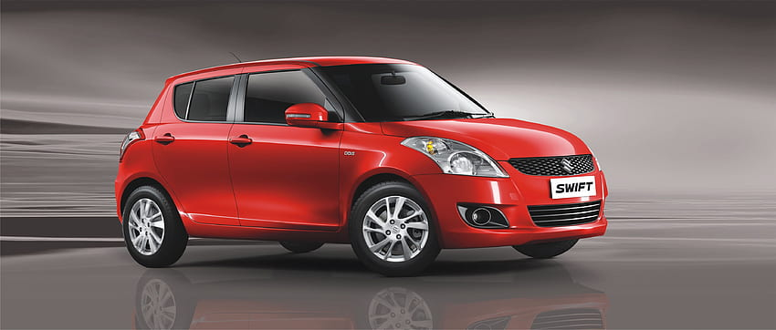
Hypothesis
Transmission Type has Effect on prices.
Fuel Type has effect on prices.

Slide 4
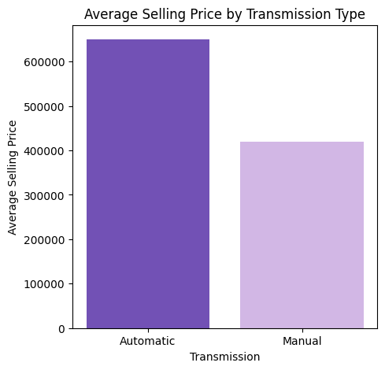
Analysis and Findings
The bar graph shows that cars with automatic transmissions have a significantly higher average selling price than those with manual transmissions. Automatic cars are priced around 54% higher on average compared to Manual cars.

Slide 5
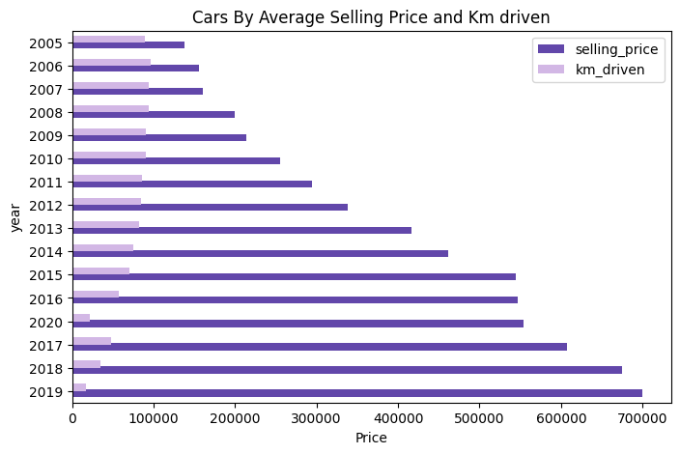
Analysis and Findings
By seeing the horizontal bar chart it has been observed that by focusing on Years in Each Year Selling Prices Increases as the Km Driven Decreases . 2005-2020 there is a significant difference between Selling Prices. Km Driven and Selling Price has Negative Correlation. The More Older and More km Driven Car will be the Less it’s Price Will Be and Reverse for the New Cars

Slide 6
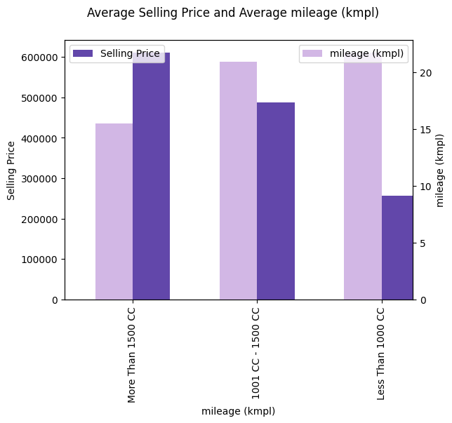
Analysis and Findings
When looking at Average Selling Prices and Average Mileage (kmpl) By Engine Type In Bar Chart It has seen that . Less than 1000cc cars has better Mileage and Less Price then 1001-1500cc cars has more price and less Mileage than 1000cc cars . More Than 1500cc cars has most Selling Price and Least Mileage as compared to Other Engine Types

Slide 7
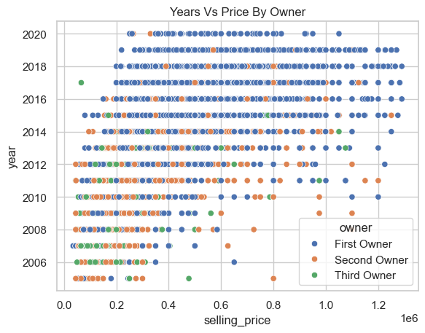
Analysis and Findings
By observing Years vs Price by Owner Scatterplot . We can see that First Owner Cars has Most Price as compared to Second Owner and Third Owner. This states that the newer the car will be the more it will cost.

Slide 8
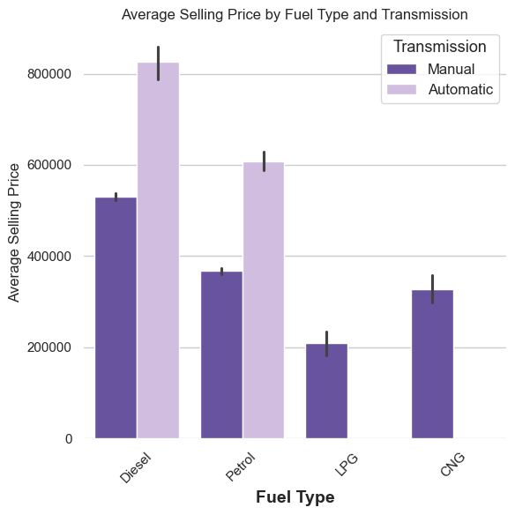
Analysis and Findings
By seeing this Bar plot we can observe that Diesel cars Cost Much in both Manual and Automatic Transmission then on number to Petrol cars . CNG and LPG cars does not have Automatic Transmission Type They Cost the Least to the Customers.

Slide 9
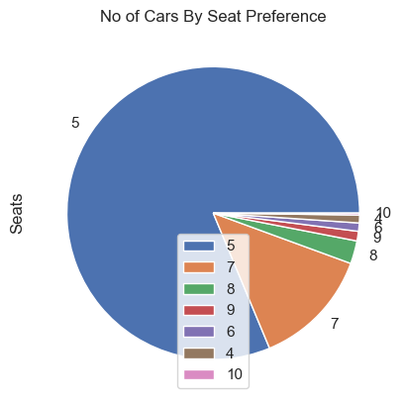
Analysis and Findings
By Seeing this Pie Chart we can more people prefer to buy 5 seater cars and 7 seater cars .
10 seater cars has least preference and others also have least preference.

Slide 10
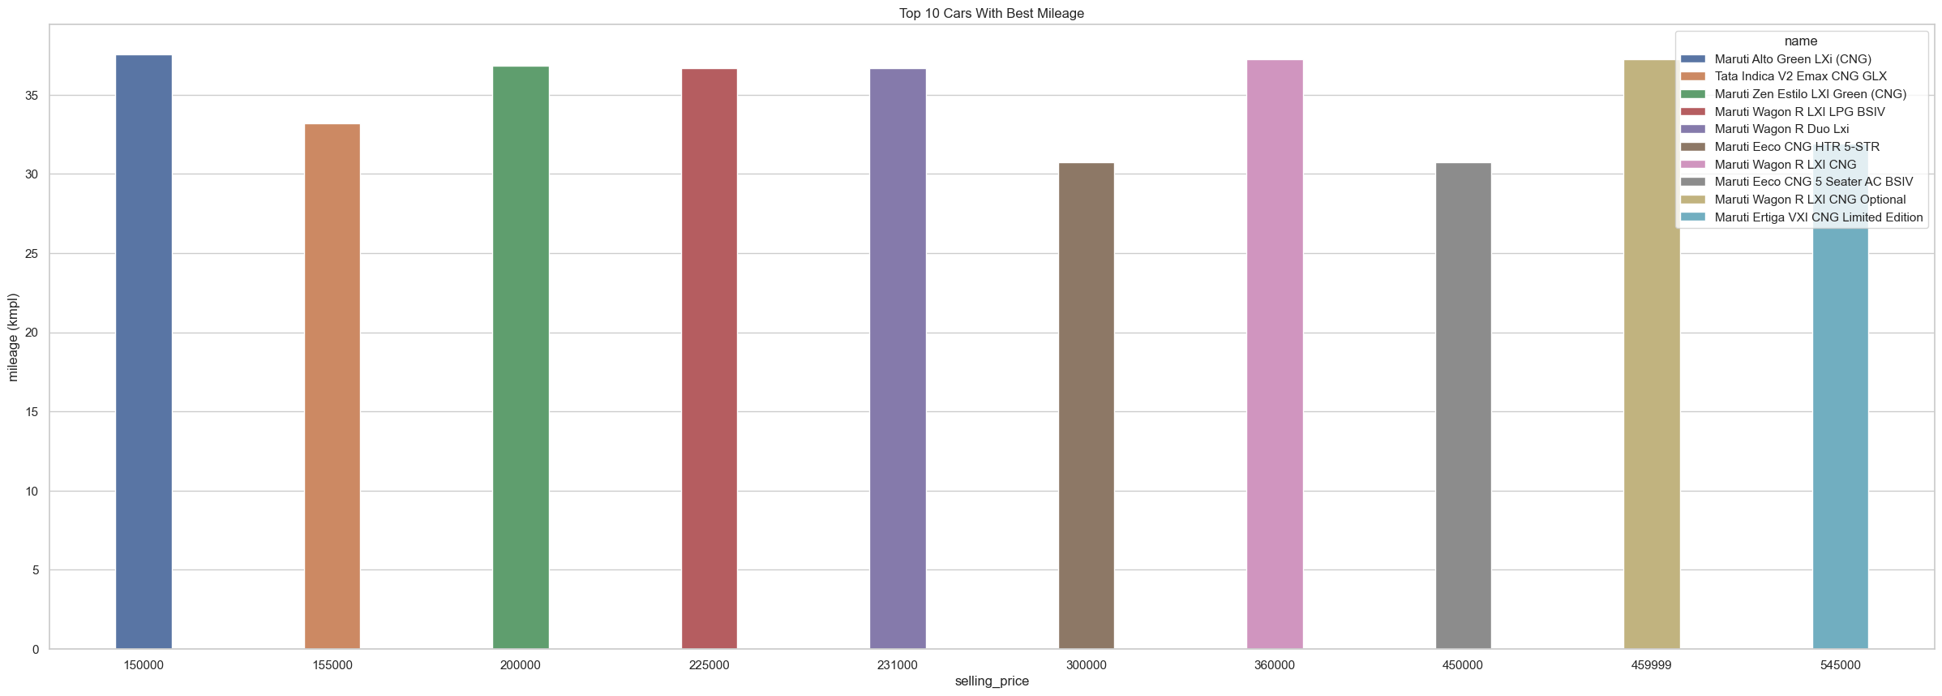
Analysis and Findings
These are top 10 cars with Best mileage and it is observed they also have less price.

Slide 11
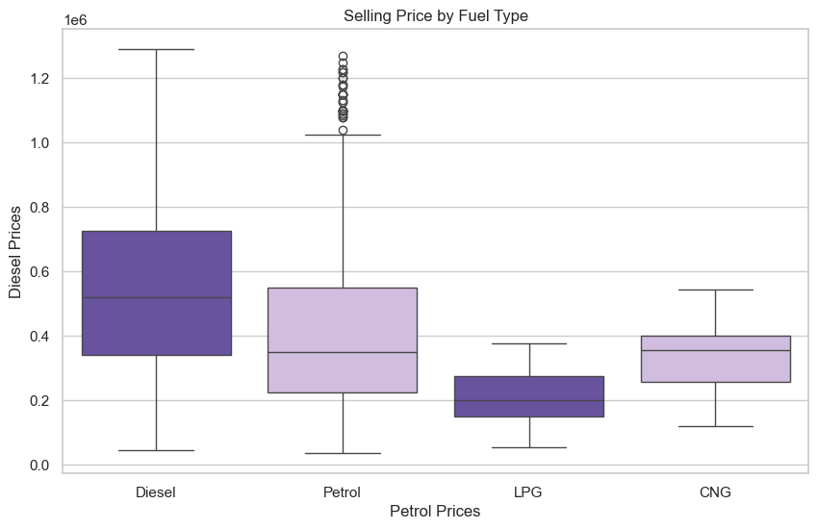
Hypothesis 1 Difference between Average Price of Petrol and Diesel
By Determining the P-value and Seeing in Scatterplot We can see There is A Significant Difference Between Average Selling Prices of Fuel

Slide 12
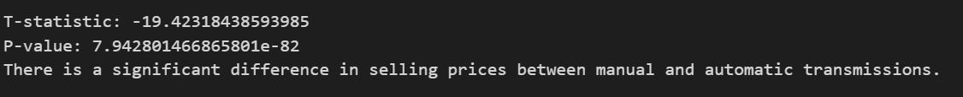
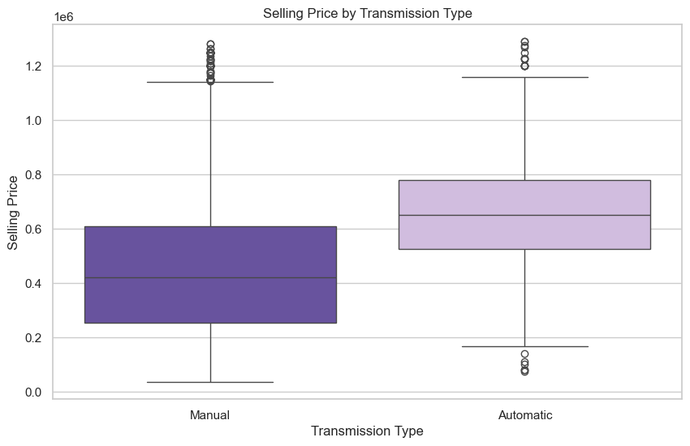
Hypothesis 2 Difference between Average Price of Transmission
By Determining the P-value and Seeing in Scatterplot We can see There is A Significant Difference Between Average Selling Prices of Transmission Type

Slide 13
Suggestions
The Business should Provide Discounts on the Automatic Transmission more than 1000cc Diesel and Petrol Cars as these cars cost very much high and they Bring most of the Revenue to the Business by Providing Little Discounts and Marketing Campaigns in this way they can attract more customers to but these cars that will increase business revenue.
The Business should also store more of Automatic Transmission Cars Inventory and Less than 1000 cars inventory and Provide discounts only on Automatic Transmission Cars inventory so that they can sell more and attract more customers .
The Business should focus on Cars less than 1000 cc and less than 1000cc cars as well because these cars are affordable by most of the people so There are chances that these cars will be Sold faster these cars will bring less revenue to the business but this revenue is definitely important for the business
The Business should provide offers and discounts for 8 to 10 seater cars because these cars has least sales by providing offers and discounts and extra facilities and marketing customers will go for these cars.

Slide 14
Suggestions
The Business Should Also Store These top 10 cars as these cars has Best Mileage and Best Pricing as the Prices of Fuel tend to increase people prefer cars with best mileage and if the cars has best price then people will but these cars . The Business should start the campaign to make people aware of the old cars with the best price and mileage this will attract them and they will buy these cars.

Slide 15
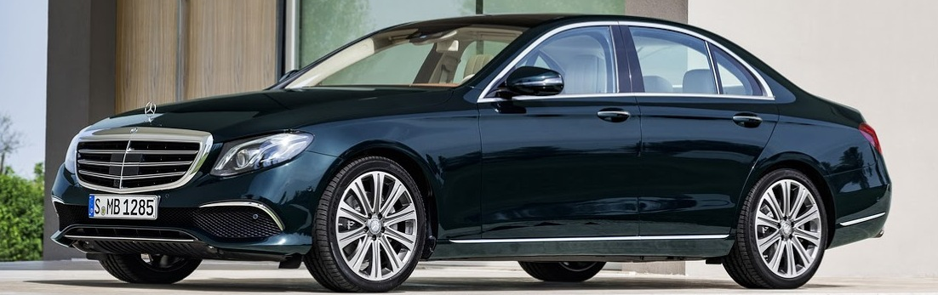
Thank you
Amish Ilyas | ilyasamish@gmail.com|

